Slide 1
CSE 5330: Database Management
SQL> Select Project_Presentation
SQL> FROM CSE_5300.database_mgMt
SQL> Where Team_no = ‘12’ And
project_name like ‘DoormaT Farm’
SQL> order by slide_no;

Slide 2

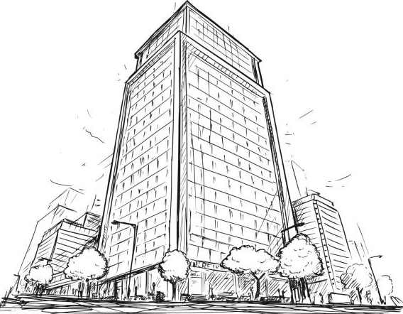
Doormat Farm
Doormat Farm

Slide 3

About Doormat Farm
People who lead busy lives, such as students and working professionals, often lack the time to make meals and worry that the processed food they buy at the grocery store may harm them. We provide a ready-to-eat meal kit service that can be prepared in a matter of minutes.
However, given that there are numerous delivery services available that can provide meals in a matter of minutes, we require the best management service to improve the caliber and variety of meals, cut down on the time and distance delivery drivers must go, and find the best subscription packages.

Slide 4




Meet the team
Manjeet Acharya
Sai santoshi praneetha
MegHana Mendu
Harshada THombre

Slide 5
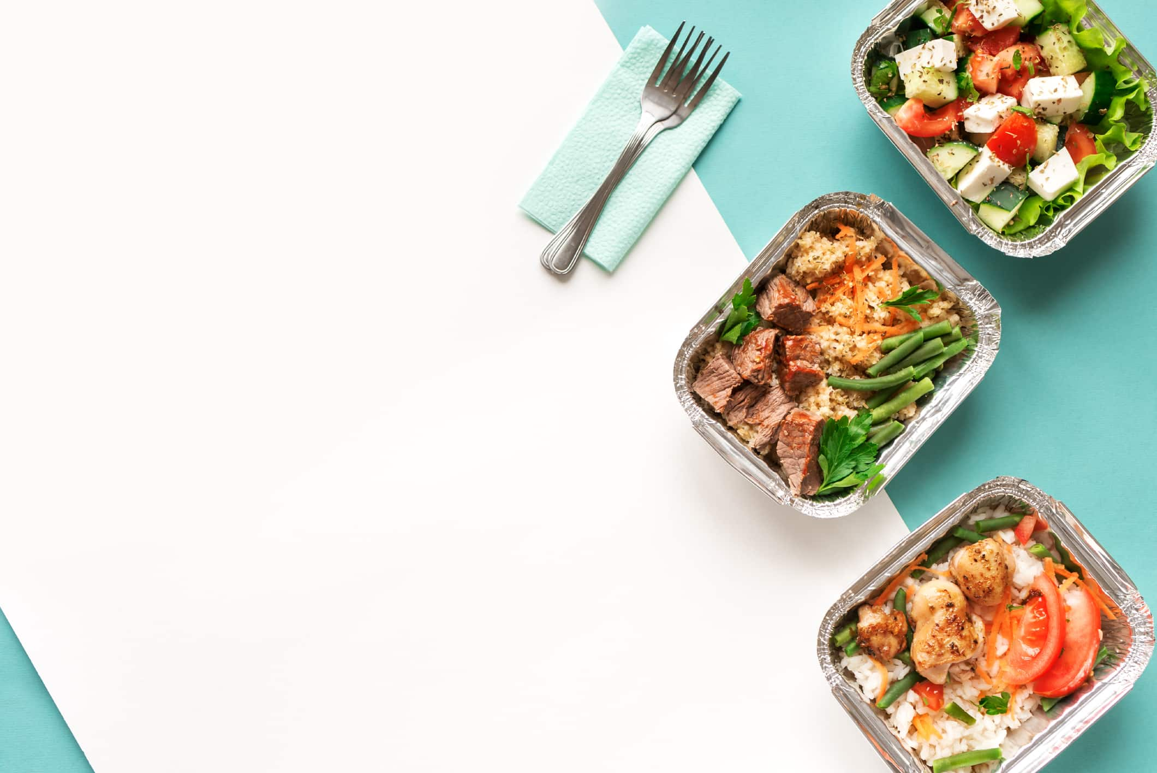
Implementing doormat farm in real world
Implementing this initiative in the real world can have numbers of positive effects. Here are a few possible advantages:
Healthy Home-produced Meals: Busy people can obtain wholesome, freshly cooked meals produced with high-quality ingredients thanks to the home-made meal-kit service. This can assist them in avoiding relying on store processed foods, which may be less nourishing and possibly hazardous to their health.
Time-saving Convenience: For people who are busy and only have a short amount of time to cook, meal kits that can be put together quickly can save time. Without spending a lot of time meal planning, grocery shopping, and food preparation, they can just follow the directions in the meal kit and have a prepared dinner ready to eat.

Slide 6

Implementing doormat farm in real world
Diverse Meal Options: The home-made meal-kit service can give flexibility and convenience to consumers with a diversity of tastes and dietary demands by offering a wide array of meal options that accommodate to varied dietary preferences and constraints. This can make it easier for them to avoid eating the same thing every day and can also be tailored to their individual tastes, making it a practical and unique solution for their hectic schedules.
Optimal Subscription Plans: By identifying the top subscription plans through market research, clients may select the ones that best suit their requirements and financial situation, giving them a reasonable option for routine meal delivery. The home-cooked meal kit business may benefit from an increase in client retention, loyalty, and income as a result.

Slide 7
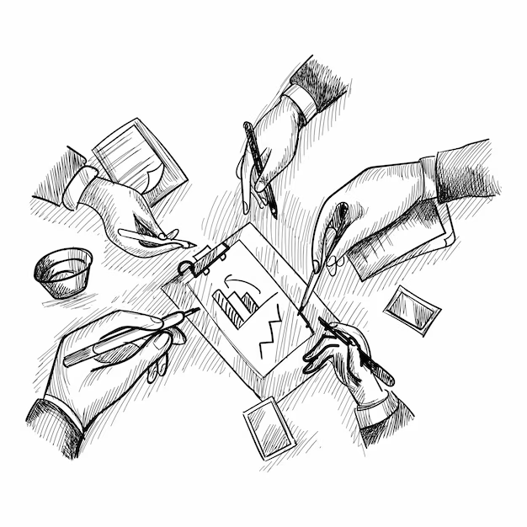

Project Overview

Slide 8
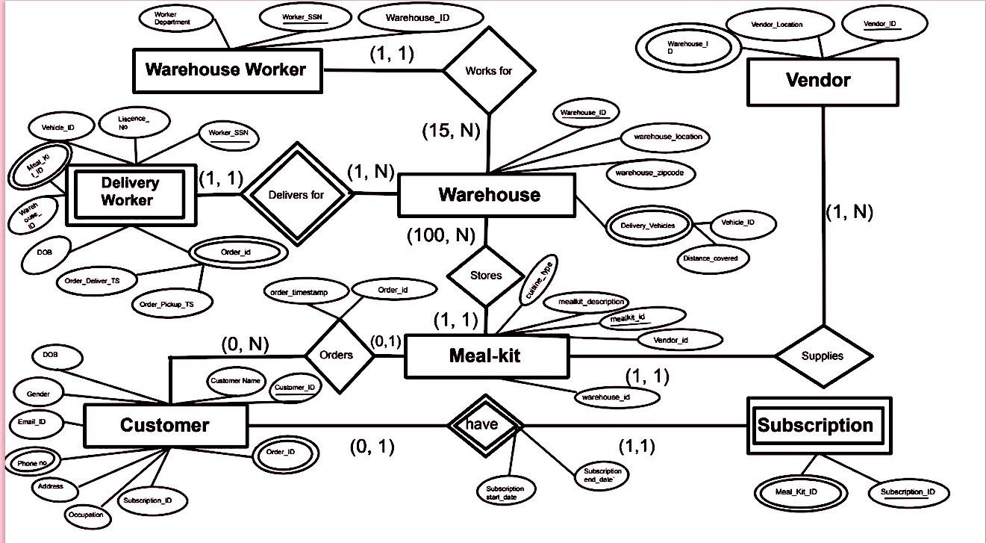
Extended entity relationship diagram

Slide 9

Spring23_S003_12_Delivery_Mealkit;
Spring23_S003_12_Mealkit;
Spring23_S003_12_customer1;
Spring23_S003_12_Customer2;
Spring23_S003_12_Subscription1;
Spring23_S003_12_Customer_Phoneno;
Spring23_S003_12_customer_order;
Spring23_S003_12_Subscription2;
Spring23_S003_12_Subscription_mealkit;
Spring23_S003_12_orders1;
Spring23_S003_12_orders2;
Tables
Spring23_S003_12_vendor
Spring23_S003_12_Warehouse2;
Spring23_S003_12_Warehouse1;
Spring23_S003_12_vendor_warehouse;
Spring23_S003_12_Delivery_Worker1;
Spring23_S003_12_warehouse_deliveryVehicle;
Spring23_S003_12_Warehouse_worker;
Spring23_S003_12_Delivery_Worker2;
Spring23_S003_12_Delivery_Order;

Slide 10


Project goals

Slide 11
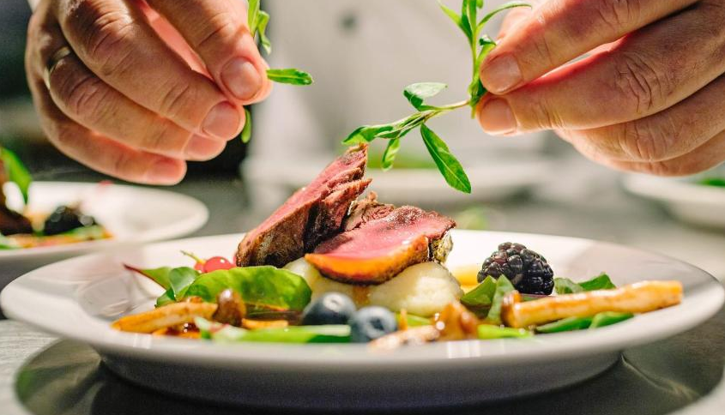
Project Goals
1. Find the most popular cuisine-types and arrange them from most sold to least sold.
SELECT m.cusine_type, count(m.mealkit_id) as Total_Mealkits_Sold
FROM Spring23_S003_12_Mealkit m, Spring23_S003_12_Subscription_mealkit o2
WHERE m.mealkit_id = o2.mealkit_id
GROUP BY m.cusine_type
ORDER BY count(m.mealkit_id) DESC;
CUSINE_TYPE_______.TOTAL_MEALKITS_SOLD
Indian 9
Italian 7
Greek 6
Mediterranean 5
Chinese 5
American 3

Slide 12
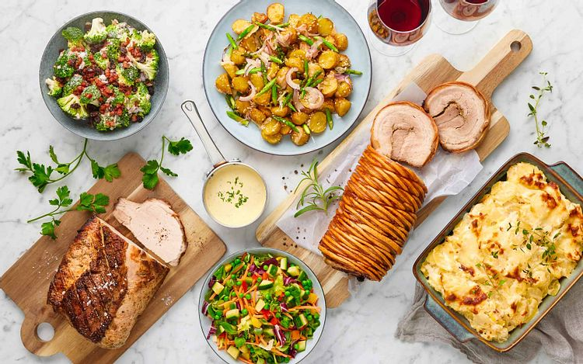
Project Goals
2. Find the most ideal areas to build warehouses.
select c2.Address, count(o1.customer_id) as Number_Of_Orders
from Spring23_S003_12_Customer2 c2 , Spring23_S003_12_orders1 o1
where c2.customer_id = o1.customer_id
group by c2.Address
order by Number_Of_Orders desc
fetch first 5 rows only;
ADDRESS NUMBER_OF_ORDERS
================================================== ================
080 Scofield Road 8
01049 Anderson Crossing 6
8057 Michigan Parkway 3
880 Schmedeman Parkway 3
9323 Melvin Trail 3

Slide 13
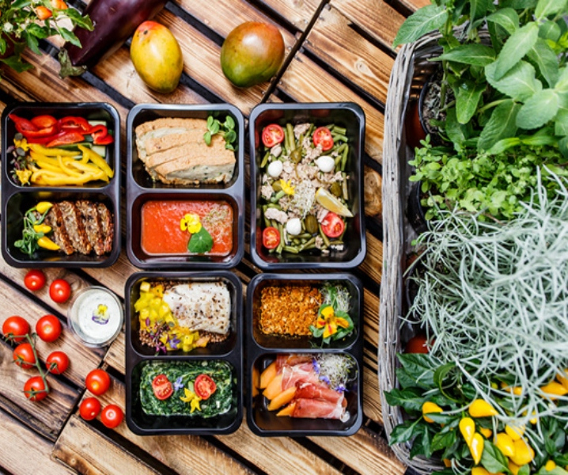
Project Goals
3. Find the best and worst delivery drivers. Best drivers deliver faster with respect to the miles they have to travel.
SELECT wd.warehouse_id, dw.worker_ssn, AVG(CAST(((TO_DATE(Order_DeliverTS, 'YYYY-MM-DD HH24:MI:SS') - TO_DATE(Order_PickupTS, 'YYYY-MM-DD HH24:MI:SS'))*24*60) AS DECIMAL(10,2))) AS Average_Delivery_Time,AVG(Distance_Covered_per_order) as Mean_Distance
FROM Spring23_S003_12_warehouse_deliveryVehicle wd
JOIN Spring23_S003_12_delivery_worker1 dw ON wd.warehouse_id = dw.warehouse_id
JOIN Spring23_S003_12_Delivery_Order o ON o.Worker_SSN = dw.worker_ssn
GROUP BY wd.warehouse_id, dw.worker_ssn,Distance_Covered_per_order
ORDER BY Average_Delivery_Time ASC
FETCH FIRST 5 ROWS ONLY;
Best Delivery
Drivers
WAREHOUSE_ID WORKER_SSN AVERAGE_DELIVERY_TIME MEAN_DISTANCE
==================== =========== ===================== =============
WARE-k420 619-55-4707 5.38 9.54
WARE-a904 723-85-8097 51.45 1.1
WARE-b147 852-74-0539 53.2 14.27
WARE-7031 606-05-3860 54.775 8.91
WARE-O053 815-12-7943 57.045 14.83

Slide 14
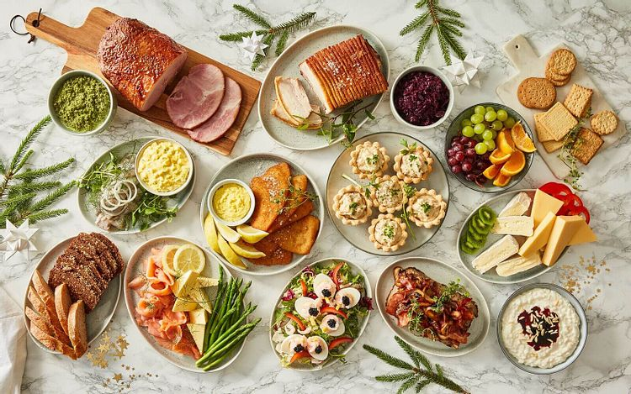
Project Goals
SELECT wd.warehouse_id, dw.worker_ssn, AVG(CAST(((TO_DATE(Order_DeliverTS, 'YYYY-MM-DD HH24:MI:SS') - TO_DATE(Order_PickupTS, 'YYYY-MM-DD HH24:MI:SS'))*24*60) AS DECIMAL(10,2))) AS Average_Delivery_Time, AVG(Distance_Covered_per_order) as Mean_Distance
FROM Spring23_S003_12_warehouse_deliveryVehicle wd
JOIN Spring23_S003_12_delivery_worker1 dw ON wd.warehouse_id = dw.warehouse_id
JOIN Spring23_S003_12_Delivery_Order o ON o.Worker_SSN = dw.worker_ssn
GROUP BY wd.warehouse_id, dw.worker_ssn,Distance_Covered_per_order
ORDER BY Average_Delivery_Time DESC
FETCH FIRST 5 ROWS ONLY;
WAREHOUSE_ID WORKER_SSN AVERAGE_DELIVERY_TIME MEAN_DISTANCE
==================== =========== ===================== =============
WARE-T800 850-84-9758 290.83 7.17
WARE-a687 400-98-9436 269.2 29.93
WARE-a687 400-98-9436 269.2 16.83
WARE-W514 766-20-9923 259.67 25.48
WARE-W514 766-20-9923 259.67 24
Worst Delivery
Drivers

Slide 15
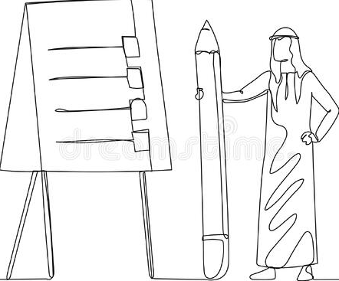
Project Takeaway

Slide 16

Project Takeaway
All the team members decided a time comfortable for all of us and met in the meeting rooms and on Microsoft Teams.
We discussed and divided the work amongst 4 of us so that we could go back and work at our own time.
For the tasks which had dependency on other team members, all 4 of us worked together and got the things done.
To make sure that everyone on the team is working toward the same objectives for each assignment or project, we set clear goals and deadlines for each one.
We monitored the progress of tasks and projects to ensure that they proceed as intended and to spot any possible bottlenecks. Regular monitoring enabled us to take prompt action and guarantee smooth project completion progress.

Slide 17

Project Takeaway
Phase 4 was slightly challenging because of the time constraints and the amount of work we had. This phase required a lot of brainstorming.
In addition, if we were asked to restart the project, we would start with Phase 4 since we wanted to incorporate more business goals and make the database system as effective as possible, which may be useful in the real world in a more effective way.
Also, to change the method of our approach, we would have divided the team into 2 teams, and play the roles of Business owner and Database Designers, so that we could find the areas in which improvement is needed, and which attributes are lacking.

Slide 18

Project Takeaway
With what we have created, we are content. A thorough approach was followed from topic selection to composing the inquiries. We put a lot of effort into each stage of the project, and as a result, we are happy with the results.
This project will make our resumes strong with all the database knowledge we have gained as we have developed it from scratch, and we are aware of all the phases of a real-time Database Design and implemented that in the project, along with collaborative teamwork.

Slide 19

Project Takeaway
Our takeaway from the project was to understand the importance of Data Analysis in the business. It emphasizes the value of customer-centricity and the necessity of taking a methodical, planned approach to projects in order to succeed. This lesson can be applied to future projects to prioritize customer happiness, align project goals with corporate objectives, and maintain a methodical approach to project, time management, and teamwork which can result in more successful outcomes.

Slide 20

Any questions?
Team 12

